Slide 1
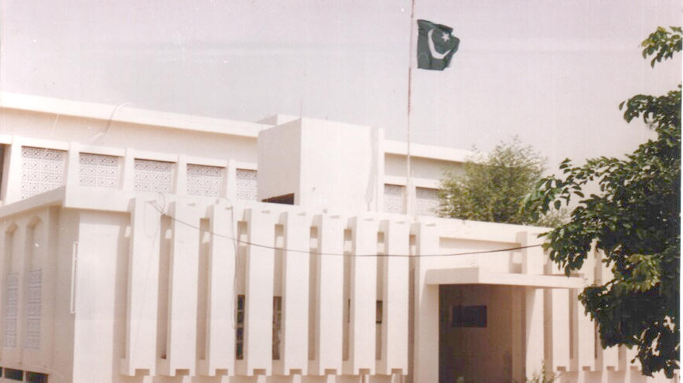
CURRICULUM AND LEARNING MATERIAL
BUREAU OF CURRICULUM AND EXTENSION WING SINDH JAMSHORO
By: Muhammad Idrees Jatoi

Slide 2
The Role of Bureau of Curriculum for the Implementation of Early Childhood Education in Sindh
Through ADP scheme 2002-03, Government of Sindh initiated the work on ECE. In this regard following activities were carried out
Reviewing and Finalizing of National Curriculum of Early Childhood Education 2002
Printing hard copies of National Curriculum of ECE June, 2003 and January 2005
Translation and Printing of ECE Curriculum in Urdu and Sindhi Languages 2004-05
Development of Teachers guide on ECE in Sindhi and Urdu Languages 2004-05

Slide 3
ECE Curriculum 2007
Identification of core concepts of ECE in the PTC, CT, ADE and B.Ed Elementary Curriculum 2010 collaboration UNESCO
Developed textual material in the Early Childhood Education for the ADE and B.Ed Elementary Trainee Teachers (Sindhi & Urdu version collaboration UNESCO
Review and Finalizing Sindhi version of Early Childhood Education 2007, by UNICEF

Slide 4
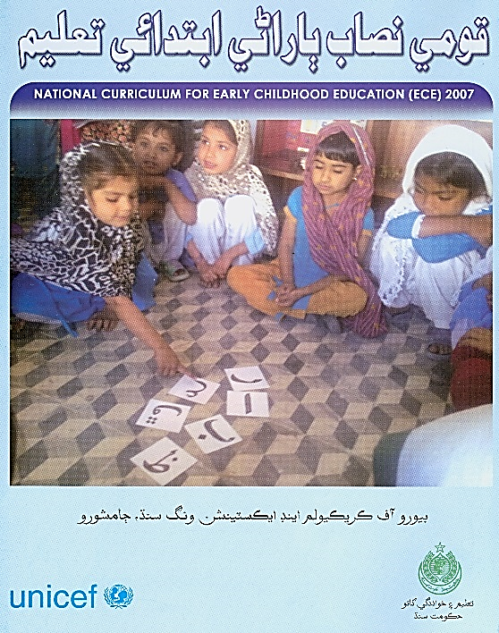
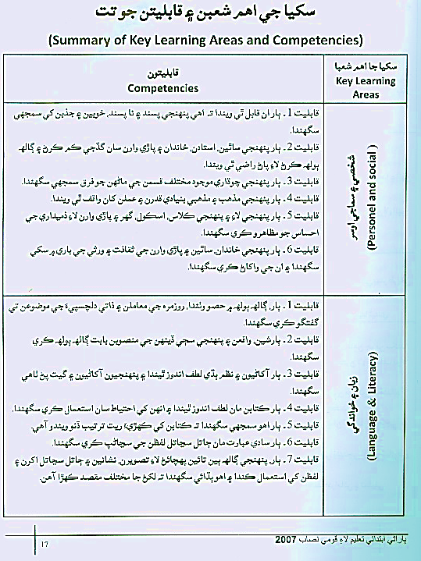
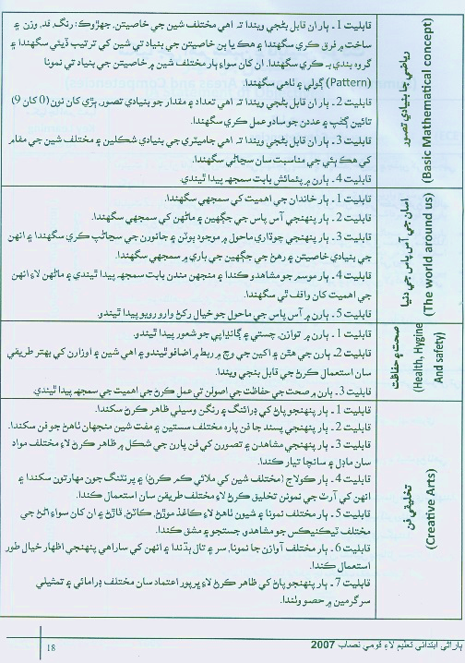
Review of the sindhi translation of ece curriculum
The expert team of bureau of curriculum reviewed the Sindhi translation of ECE
ECE Curriculum (Sindhi Version) Printed by UNICEF Sindh

Slide 5
DISSEMINATION OF ECE CURRICULUM
The Bureau of Curriculum sent the ECE Curriculum Copies to various stakeholders included: Reform Support Unit, STEDA, PITE Sindh Nawabshah , AKU-IED, All District Education Officers, All Elementary Colleges of Education, All practicing Schools of Sindh, Sindh Textbook Board, Board of Intermediate & Secondary Education, Education Faculty of Universities in Sindh, Various NGOS, Prominent Educationists and Selected Schools

Slide 6
Scheme of Studies
Early Childhood Education
Age 4/5, Full day nursery of scholars from 08:30 to 12:30
Language Experience Block (Native language / Urdu/ English)
Phonics – Alphabets
Rhymes – Single syllable words
Conversation in simple sentences
Written work (Recording oral language)
Basic numeracy, number line
Heritage Block
Folk tales from regional, national and Islamic sources
Heroes of our History and contemporary world
Creative Arts and Drama
Patriotism
Shared cultural values and norms of conduct
Environment Block
Community study (Home, Village, City)
Nature Study (Plants, Animals, Life cycle)
Seasons (growth and change)

Slide 7
Key Learning Areas and Competencies in ECE Curriculum 2007
Personal and Social Development 6 Competencies
Language and Literacy 7 Competencies
Basic Mathematical Concepts 4 Competencies
The word around us 5 Competencies
Health Hygienic and safety 3 Competencies
Creative Arts 7 Competencies

Slide 8
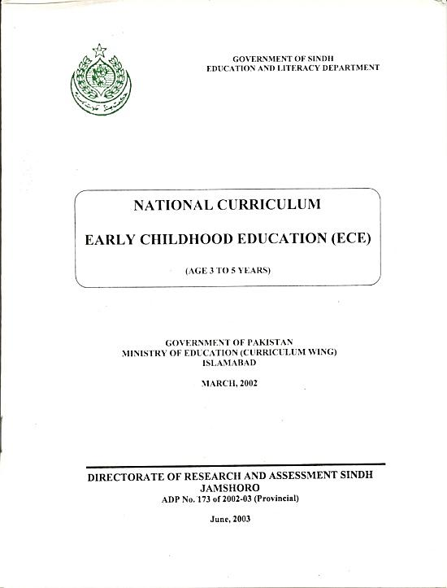
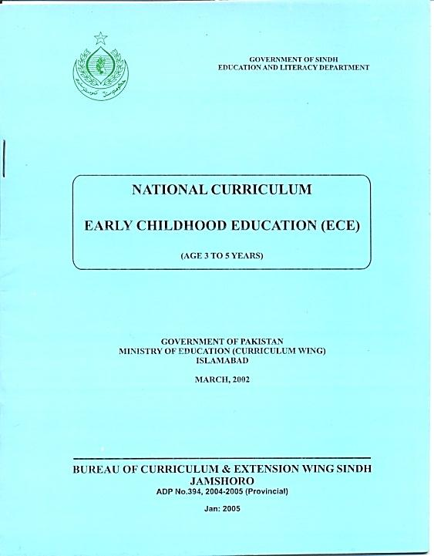
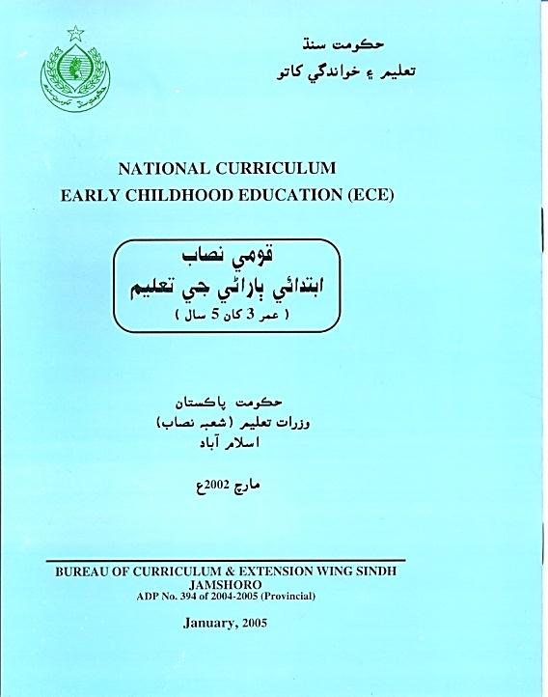
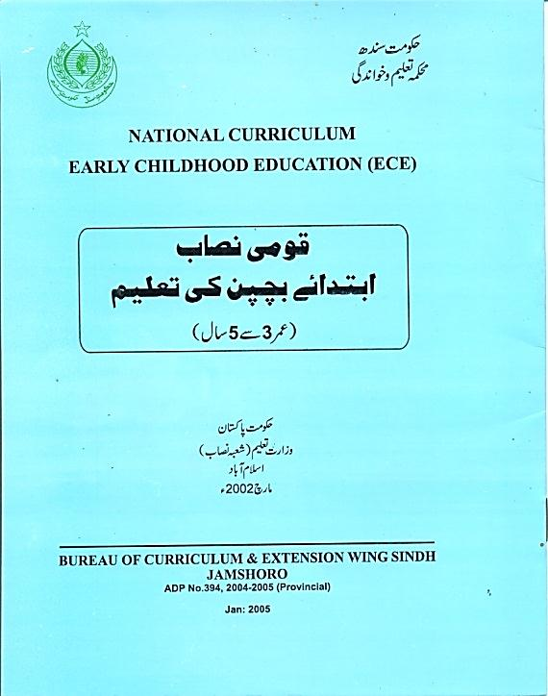

Slide 9
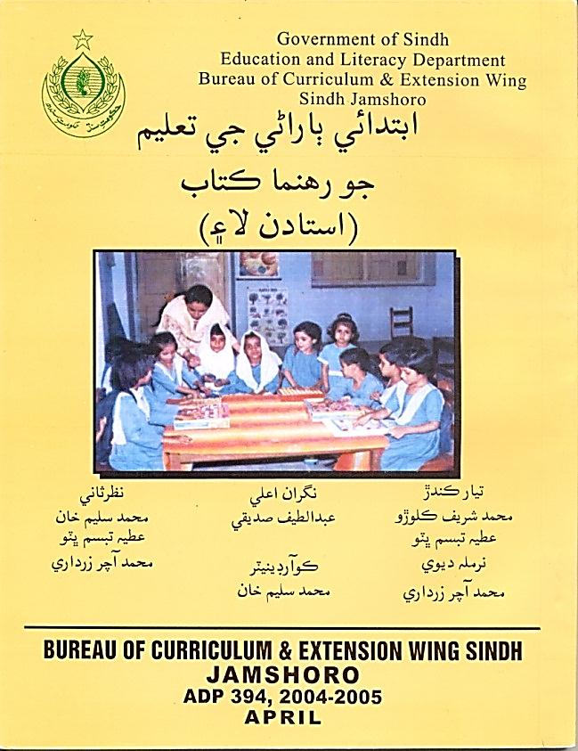
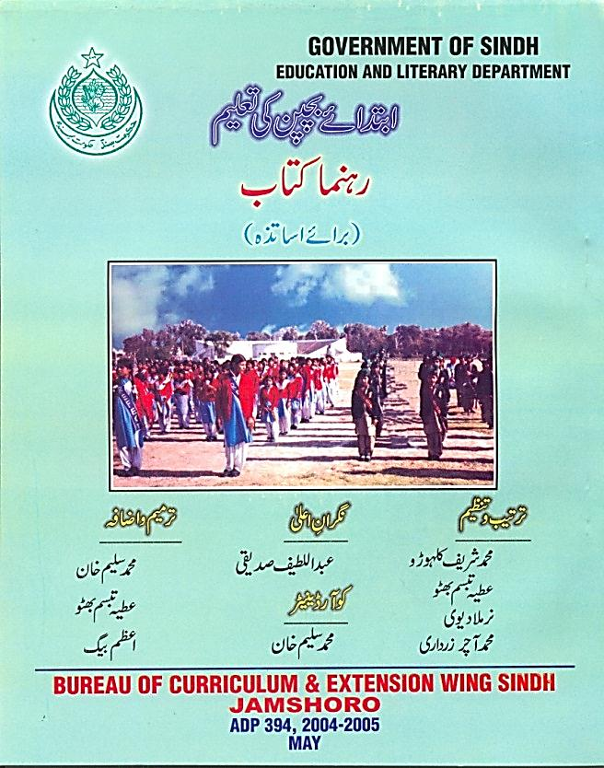

Slide 10
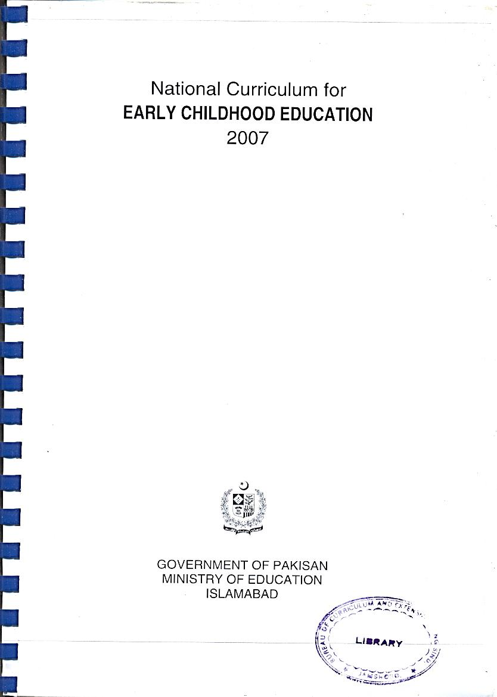

Slide 11
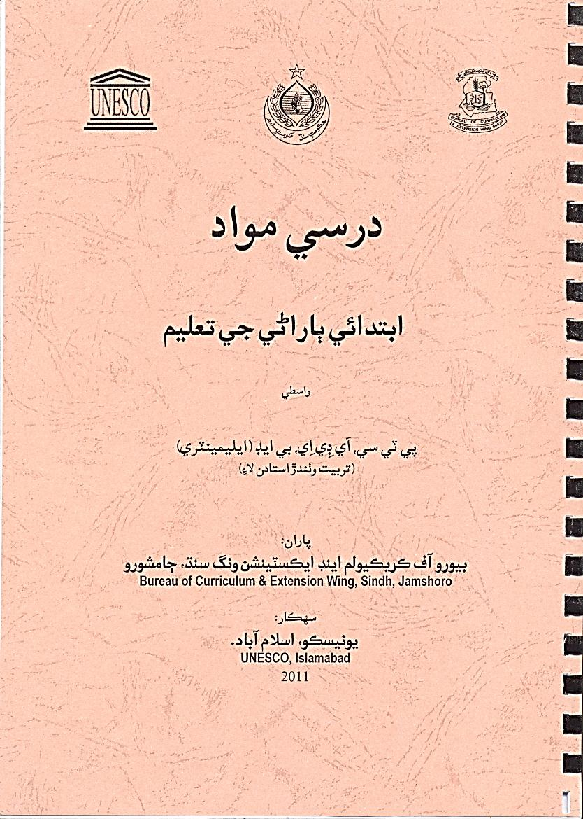

Slide 12
Thematics Working Groups
On the recommendations of 2nd Policy dialogue on “Introduction of Early Childhood Education (ECE) in Sindh” Reform Support Unit, Education and Literacy Department, Government of Sindh formed the following Technical Working Groups (TWGs) for formulation of Sindh ECE Policy.
Policy and Advocacy
Curriculum & Textbooks
Teachers Education Program
Learning Standards & Assessment
Parents & Community
The thematic working group curriculum and learning material discussed and suggested ToRs for the working

Slide 13
Group Discussion
In 8000 schools the Kachi Classes will be converted to ECE class throughout the Sindh
province (1st TWG discussion)
There should not be any formal assessment for ECE class students
The NC for ECE should be implemented in two years at schools. So, a child should be enrolled in Kachi class at the age of 3 or 3 and a half years
The ECE curriculum document should be distributed free to all Primary Schools of Sindh along with the free distribution of text books

Slide 14
ToRs
To adapt the ECE curriculum in line with emerging trends
and after its implementation, the curriculum document will be reviewed
To review ECE learning material/resources already developed by different organizations and identify desired quality relevant material for ECE. Further, to identify supplementary/additional quality learning material/resources suggested by the Curriculum TWG
To develop Scheme of Work for ECE

Slide 15
ToRs (Cont……….)
To make recommendations for the accessibility of ECE curriculum and learning environment to ECE class
To make recommendations for advocating the dissemination of the ECE curriculum to all stakeholders in a simple and understandable way (English, Urdu and Sindhi versions of the curriculum)
To select different themes for the research studies for the future ECE planning
To promote public private partnership for the implementation of our ToRs

Slide 16
Vision
A well structured, contextualized and well disseminated curriculum and desired learning resources/materials; enabling to nurture the holistic development of children.

Slide 17
WAY FORWARD
Adaptation of National ECE Curriculum 2007
Developed Guidelines for ECE Learning Material developers
Development of Learning material in line with ECE 2007 Curriculum
Wider dissemination of ECE Curriculum and Learning material
Identification, Selection and review of existing ECE Learning Material
Orientation of Teachers about effective use of ECE Material
Translation of ECE Material in local Language Sindhi & Urdu

Slide 18
THANKS

